Slide 1
Development Process

Slide 2
What is Software Engineering?
“The application of a systematic, disciplined, quantifiable approach to the development, operation and maintenance of software” IEEE standard 610.12-1990.
Software Engineering focuses on: » the practicalities of developing and delivering useful software » professional software development in teams » producing software products

Slide 3
LCCS Specification
1.19 Identify features of both staged and iterative design and development processes
1.23 reflect and communicate on the design and development process

Slide 4
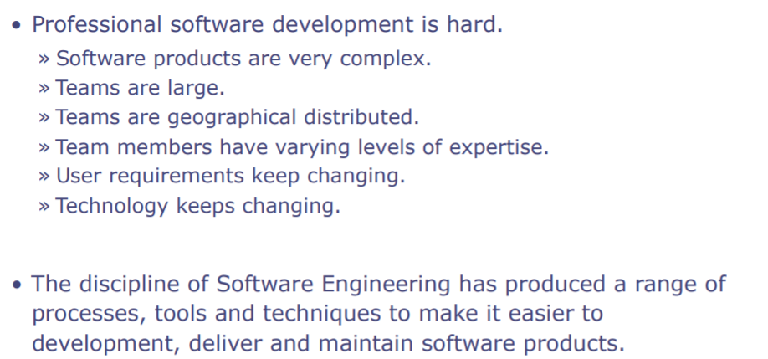

Slide 5
Software Development Process

Slide 6
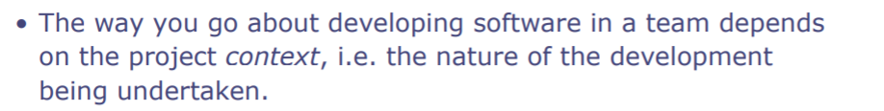
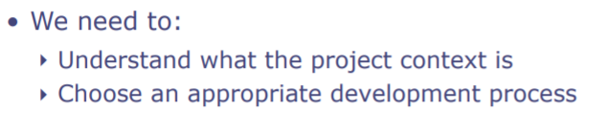
Context

Slide 7
Context
Most projects are complex and it is difficult to predict the best solution in advance
Some project are complicated but an expert could predict the best solution.
Some project are obvious and it is easy to predict the solution - for example deploying software to your 100th customer.

Slide 8
Process
There are staged/planned/waterfall design processes and iterative/agile processes

Slide 9
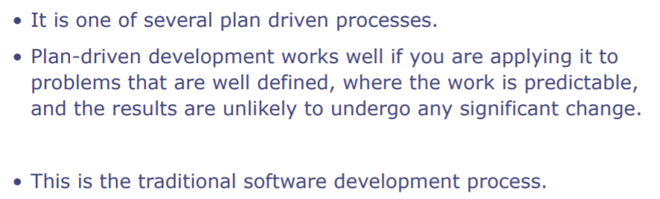
Waterfall Process

Slide 10
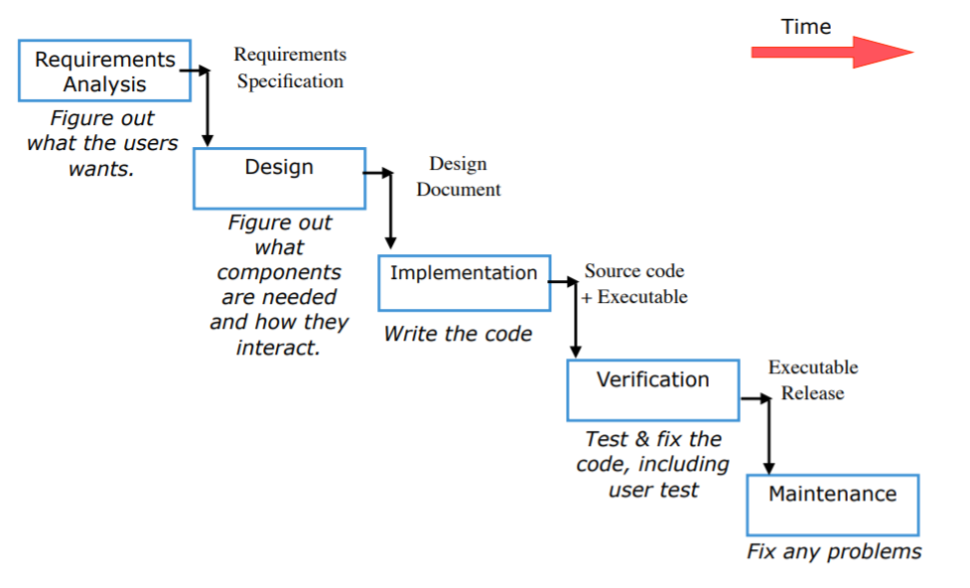

Slide 11
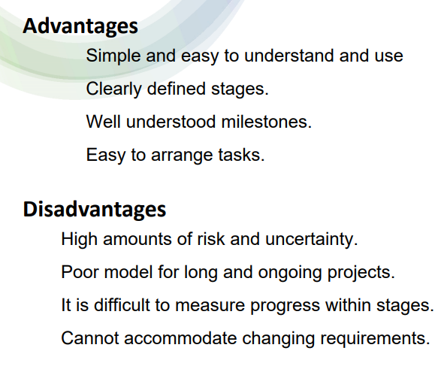

Slide 12
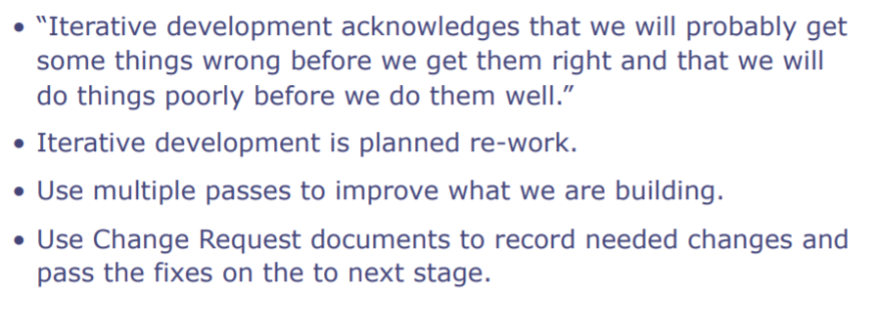
Iterative Process

Slide 13
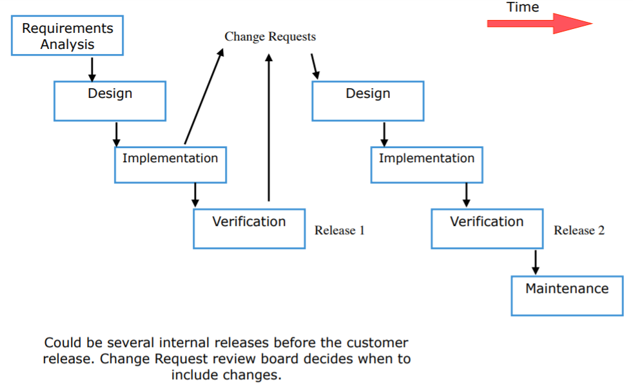

Slide 14
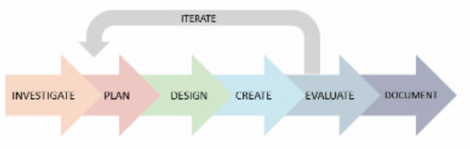
SW Dev Cycle used in LC Computer Science

Slide 15
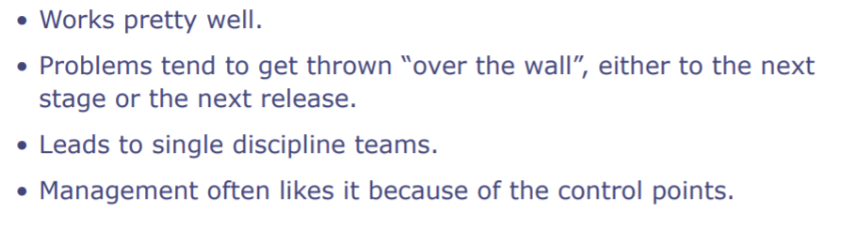
Iterative Process

Slide 16
Advantages of Iterative Development
Communication and Collaboration - frequent and close cooperation between software team and end users.
User Feedback - Team can deliver early versions of the product for feedback. This means better customer satisfaction and end user experience
Eliminate Issues early - Constant review helps eliminate issues early in the project
Reduces the overall Project cost - Software testing is part of the review process. This means errors are caught early on and can be fixed before moving on to the next stage.

Slide 17
Agile Software Development
Agile development is an “umbrella” term for several iterative and incremental software development methodologies.
While each of the agile methodologies is unique in its specific approach, they all share a common vision and core values. They all fundamentally incorporate iteration and the continuous feedback that it provides to successively refine and deliver a software system.
https://www.youtube.com/watch?v=q_R9wQY4G5I&t=20s

Slide 18
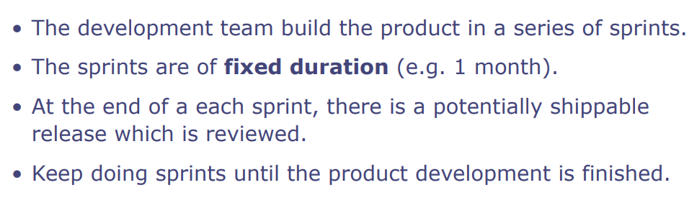
Scrum
Scrum describes a set of meetings, tools and roles that work together to help teams structure and manage their work.

Slide 19
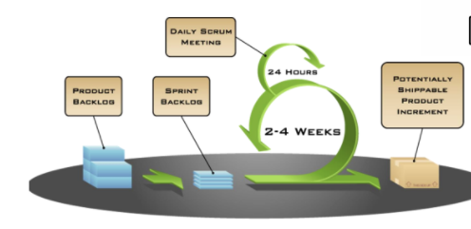
Agile - Scrum involves separating the project into sprints. The list of sprints (stages of projects) make up the Product Backlog.
The sprint backlog contains the tasks relating to the current sprint. Each sprint lasts for a period of time. At the end of the sprint, there is a potentially shippable product as that stage of the project should be tested and working. The next sprint (stage) will then be started.
In a software development team, there would be a daily scrum meeting where each team member would update on their progress. Your Coursework is an individual project but your daily scrum meeting would be where you report on your daily progress, including problems.
https://www.youtube.com/watch?v=q_R9wQY4G5I&t=20s

Slide 20
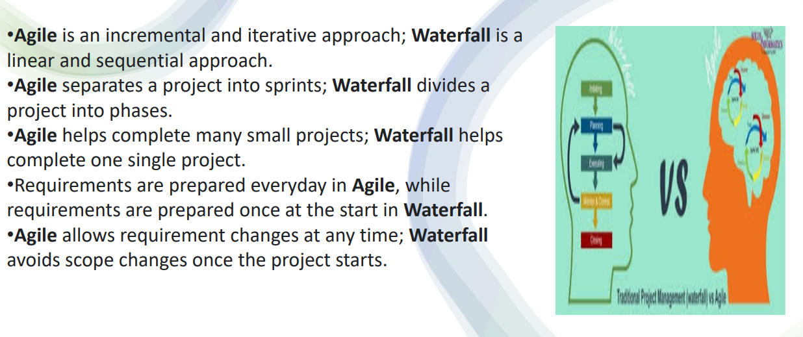
Waterfall v Iterative (Agile)

Slide 21
Stages of Software Development Process

Slide 22
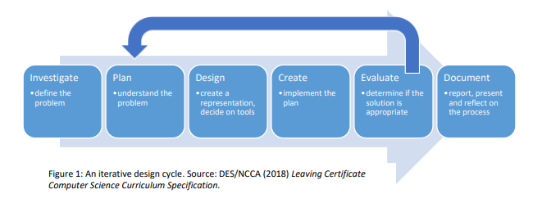
Software Development Process

Slide 23
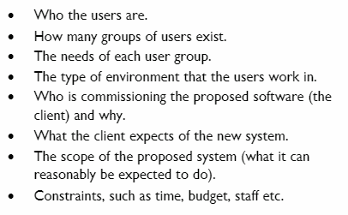
Investigate - Define the Problem
Identify and fully analyse the problem

Slide 24
Investigate - Define the Problem
Gather information - interviews, questionnaires, observations, samples of existing documentation
Requirements Specification
User requirements
Client requirements
Hardware/Software requirements

Slide 25
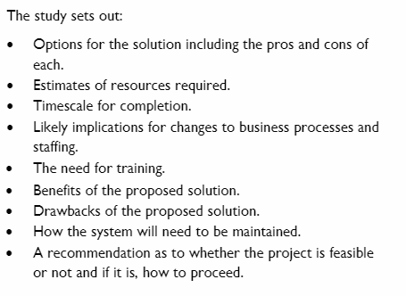
Investigate - Define the Problem
Carry out a Feasibility study - report written for client detailing whether a suitable solution is possible

Slide 26
2. Plan - Understand the Problem
A plan is necessary to ensure that everyone knows what must happen, when and by whom.
The plan should cover the various stages of the project broken into tasks.

Slide 27
Plan - Understand the Problem
Timescale
Dependencies
Hardware and Software requirements
Staffing

Slide 28
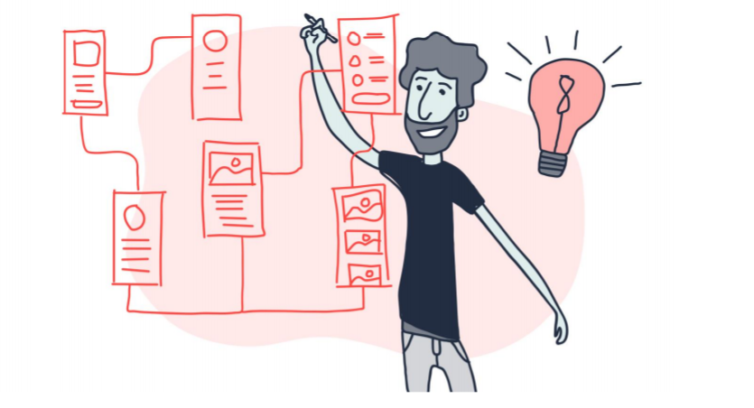
3. Design - Create a representation, decide on tools

Slide 29
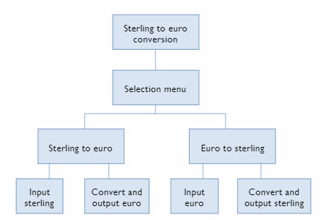
Approaches to design
Top Down Design
This approach starts with the main system at the top and breaks it down into smaller units in a hierarchical fashion.
Each unit is further broken down into smaller units.

Slide 30
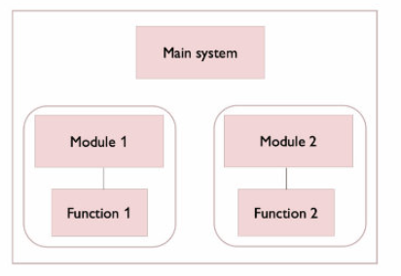
Approaches to design
Modular Design
System is divided into smaller units called modules.
Each module must represent a single self contained task or function that can be created independently of the other.

Slide 31
Approaches to design
Prototyping
A prototype is an early model of a product built to test a concept in advance and to get feedback from users.
Typically features only a few key aspects of the whole system.
Enables users to give feedback at an early stage - additional user requirements can be identified and problems recognised early on.
Often used in Engineering, Software Design.
Most valuable when designing user interfaces.

Slide 32
Approaches to design
Flowcharts
Represents the flow of operation of the system.
Clear graphical way of communicating
Difficult when complex logic is involved.

Slide 33
Design
Algorithms
All functionality should be described.
These can be shown using
Pseudocode
Normal Language
Flowcharts

Slide 34
Approaches to design
Data and Variables
All data should be listed along with their datatype.
Particularly important when dealing with databases
How will data be stored and backed up
Privacy concerns regarding data

Slide 35
4. Create - Implement the Plan
This stage involves implementing the plan/design.
Programmers create the system based on the work carried out in the previous stages.
The design might be modified due to issues that arise during implementation.
Unit Testing is carried out during this stage.

Slide 36
5. Evaluate - determine if the solution is appropriate
Testing to see if the solution works consistently.
Testing to make sure that the software does not do anything it shouldn’t.
More on Testing separately…

Slide 37
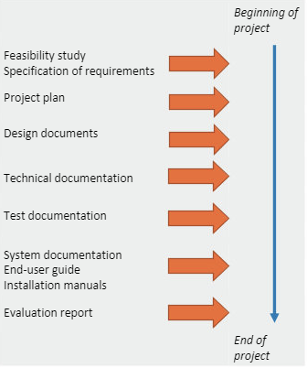
6. Document - report, present and reflect on the process
Records of all meetings, correspondence, communications, actions agreed, changes to requirements and design should be stored.
Evaluation of the project

